Slide 1
PROJECT TITLE
Predictive Maintenance Of Industrial Machinery
Presented By:
1. Pulgam.Vijay krishna-Malla Reddy College Of Engineering – CSE-DS

Slide 2
OUTLINE
Problem Statement
Proposed System/Solution
System Development Approach (Technology Used)
Algorithm & Deployment
Result (Output Image)
Conclusion
Future Scope
References

Slide 3
Problem Statement
Develop a predictive maintenance model for a fleet of industrial machines to anticipate failures before they occur. This project will involve analyzing sensor data from machinery to identify patterns that precede a failure. The goal is to create a classification model that can predict the type of failure (e.g., tool wear, heat dissipation, power failure) based on real-time operational data. This will enable proactive maintenance, reducing downtime and operational costs.

Slide 4
Proposed Solution
The proposed system addresses the challenge of predicting industrial machine failures in advance, enabling proactive maintenance and reducing unplanned downtime. It leverages data analytics and machine learning to identify patterns in sensor data that indicate potential failures. The solution will consist of the following components:
Data Collection:
Gather historical data from industrial machines, including sensor readings such as temperature, vibration, pressure, voltage, and rotational speed.
Utilize real-time data sources, including live sensor streams and contextual data like machine usage logs, maintenance history, and environmental factors to enhance prediction accuracy.
Data Preprocessing:
Clean and preprocess the collected data to handle missing values, outliers, and sensor noise that could impact prediction reliability.
Perform feature engineering to extract meaningful indicators such as rolling averages, time-lagged differences, and trends that may signal early signs of machine failure.
Machine Learning Algorithm:
Implement a machine learning algorithm, such as a multi-class classification model (e.g., Random Forest, XGBoost, or LSTM), to predict the type of machine failure (e.g., tool wear, heat dissipation issue, or power failure) based on historical sensor patterns.
Consider incorporating operational context such as time of day, machine age, and maintenance cycles to improve the accuracy of failure predictions.
Deployment:
Develop a user-friendly interface or dashboard that provides real-time predictions and failure alerts for different machines across the plant.
Deploy the solution on a scalable and reliable platform, considering infrastructure that supports low-latency processing, real-time sensor integration, and seamless user access for maintenance teams.
Evaluation:
Assess the model’s performance using appropriate classification metrics such as Precision, Recall, F1-Score, and Confusion Matrix for each failure category.
Fine-tune the model based on real-time feedback, periodic validation with new data, and continuous monitoring to maintain prediction accuracy over time.
Result:
The implementation of this predictive maintenance model will enable timely detection of potential machine failures, leading to reduced downtime, lower maintenance costs, extended equipment lifespan, and improved operational efficiency across industrial systems.

Slide 5
System Approach
System Requirements:
Sensor data (temperature, vibration, etc.)
IBM Cloud Lite environment
Libraries/Tools Required:
IBM Watsonx.ai Studio
Runtime

Slide 6
Algorithm & Deployment
Algorithm Selection:
Random Forest: For handling tabular sensor data with good interpretability.
XGBoost: For gradient-boosted decision trees with high accuracy and efficiency.
LSTM (Long Short-Term Memory): For sequential data modeling to capture temporal dependencies in sensor readings.
Data Input:
Historical Data: Sensor readings including temperature, vibration, pressure, voltage, rotational speed, and contextual logs (machine usage, maintenance history, environmental conditions).
Real-Time Data: Streaming sensor values and operational context used for live prediction.
Preprocessing: Cleaning (missing value imputation, noise reduction), feature extraction (rolling averages, time-lagged features), normalization, and contextual feature integration.
Training Process:
Data Splitting: Divide dataset into training (70%), validation (15%), and test (15%) sets.
Feature Engineering: Generate time-based and statistical features indicative of failure patterns.
Model Training: Train chosen model (Random Forest/XGBoost/LSTM) on labeled sensor data for multi-class failure prediction.
Model Serialization: Save the trained model and preprocessing pipeline for deployment.
Deployment:
Platform: IBM Cloud Lite environment leveraging IBM Watsonx.ai Studio for model hosting and runtime.
Real-Time Data Ingestion: Implement streaming data pipelines for live sensor data collection and preprocessing.
User Dashboard: Build an interface providing real-time failure alerts, prediction visualization, and maintenance scheduling.
Monitoring & Maintenance: Continuously monitor prediction accuracy; retrain the model periodically with new data.
Security: Ensure authentication, authorization, and secure data handling.

Slide 7
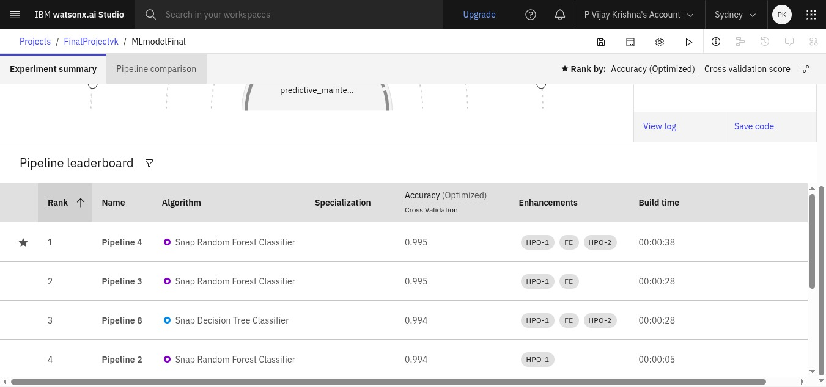
Result

Slide 8
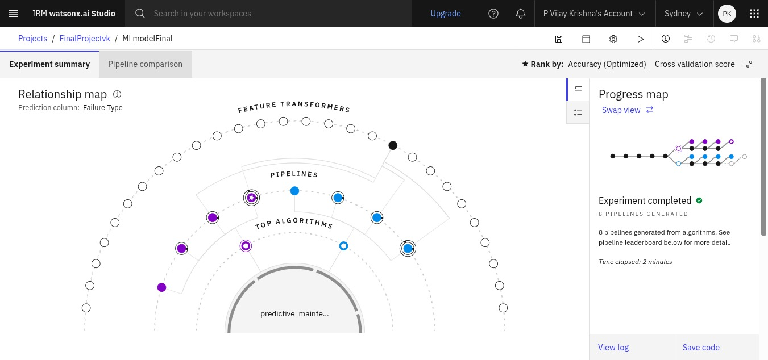
Result

Slide 9
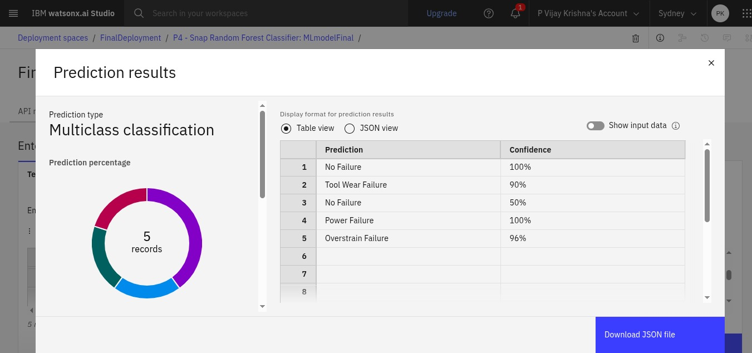
Result

Slide 10
Conclusion
The development and deployment of the predictive maintenance model for industrial machines demonstrate a significant advancement in anticipating equipment failures before they occur. By leveraging sensor data and machine learning algorithms, the system effectively identifies early warning signs of various failure types, enabling proactive maintenance strategies. This approach not only reduces unplanned downtime and maintenance costs but also enhances operational efficiency and extends the lifespan of machinery. Implemented on a scalable cloud platform with real-time data integration, the solution offers a robust and adaptable framework for ongoing industrial applications. Overall, this predictive maintenance model represents a vital step toward smarter, data-driven asset management in industrial environments.

Slide 11
Future scope
Integration of Advanced AI Techniques: Incorporate deep learning models like Transformer-based architectures or hybrid models combining CNNs and LSTMs to improve prediction accuracy and capture complex failure patterns.
Expansion to Multimodal Data: Include additional data sources such as images (thermal or visual inspections), audio signals, and video feeds to enhance the model’s understanding of machine health.
Edge Computing Deployment: Implement edge computing to process sensor data locally on machines for ultra-low latency predictions and reduced cloud dependency, enabling faster response times.
Predictive Maintenance Scheduling Optimization: Develop automated maintenance scheduling tools that leverage predictive insights to optimize resource allocation, reduce maintenance downtime, and balance operational workloads.
Anomaly Detection & Explainability: Integrate anomaly detection frameworks and explainable AI (XAI) methods to provide interpretable predictions and actionable insights to maintenance teams.

Slide 12
References
https://www.kaggle.com/datasets/shivamb/machine-predictive-maintenance-classification
IBM Cloud Documentation.

Slide 13
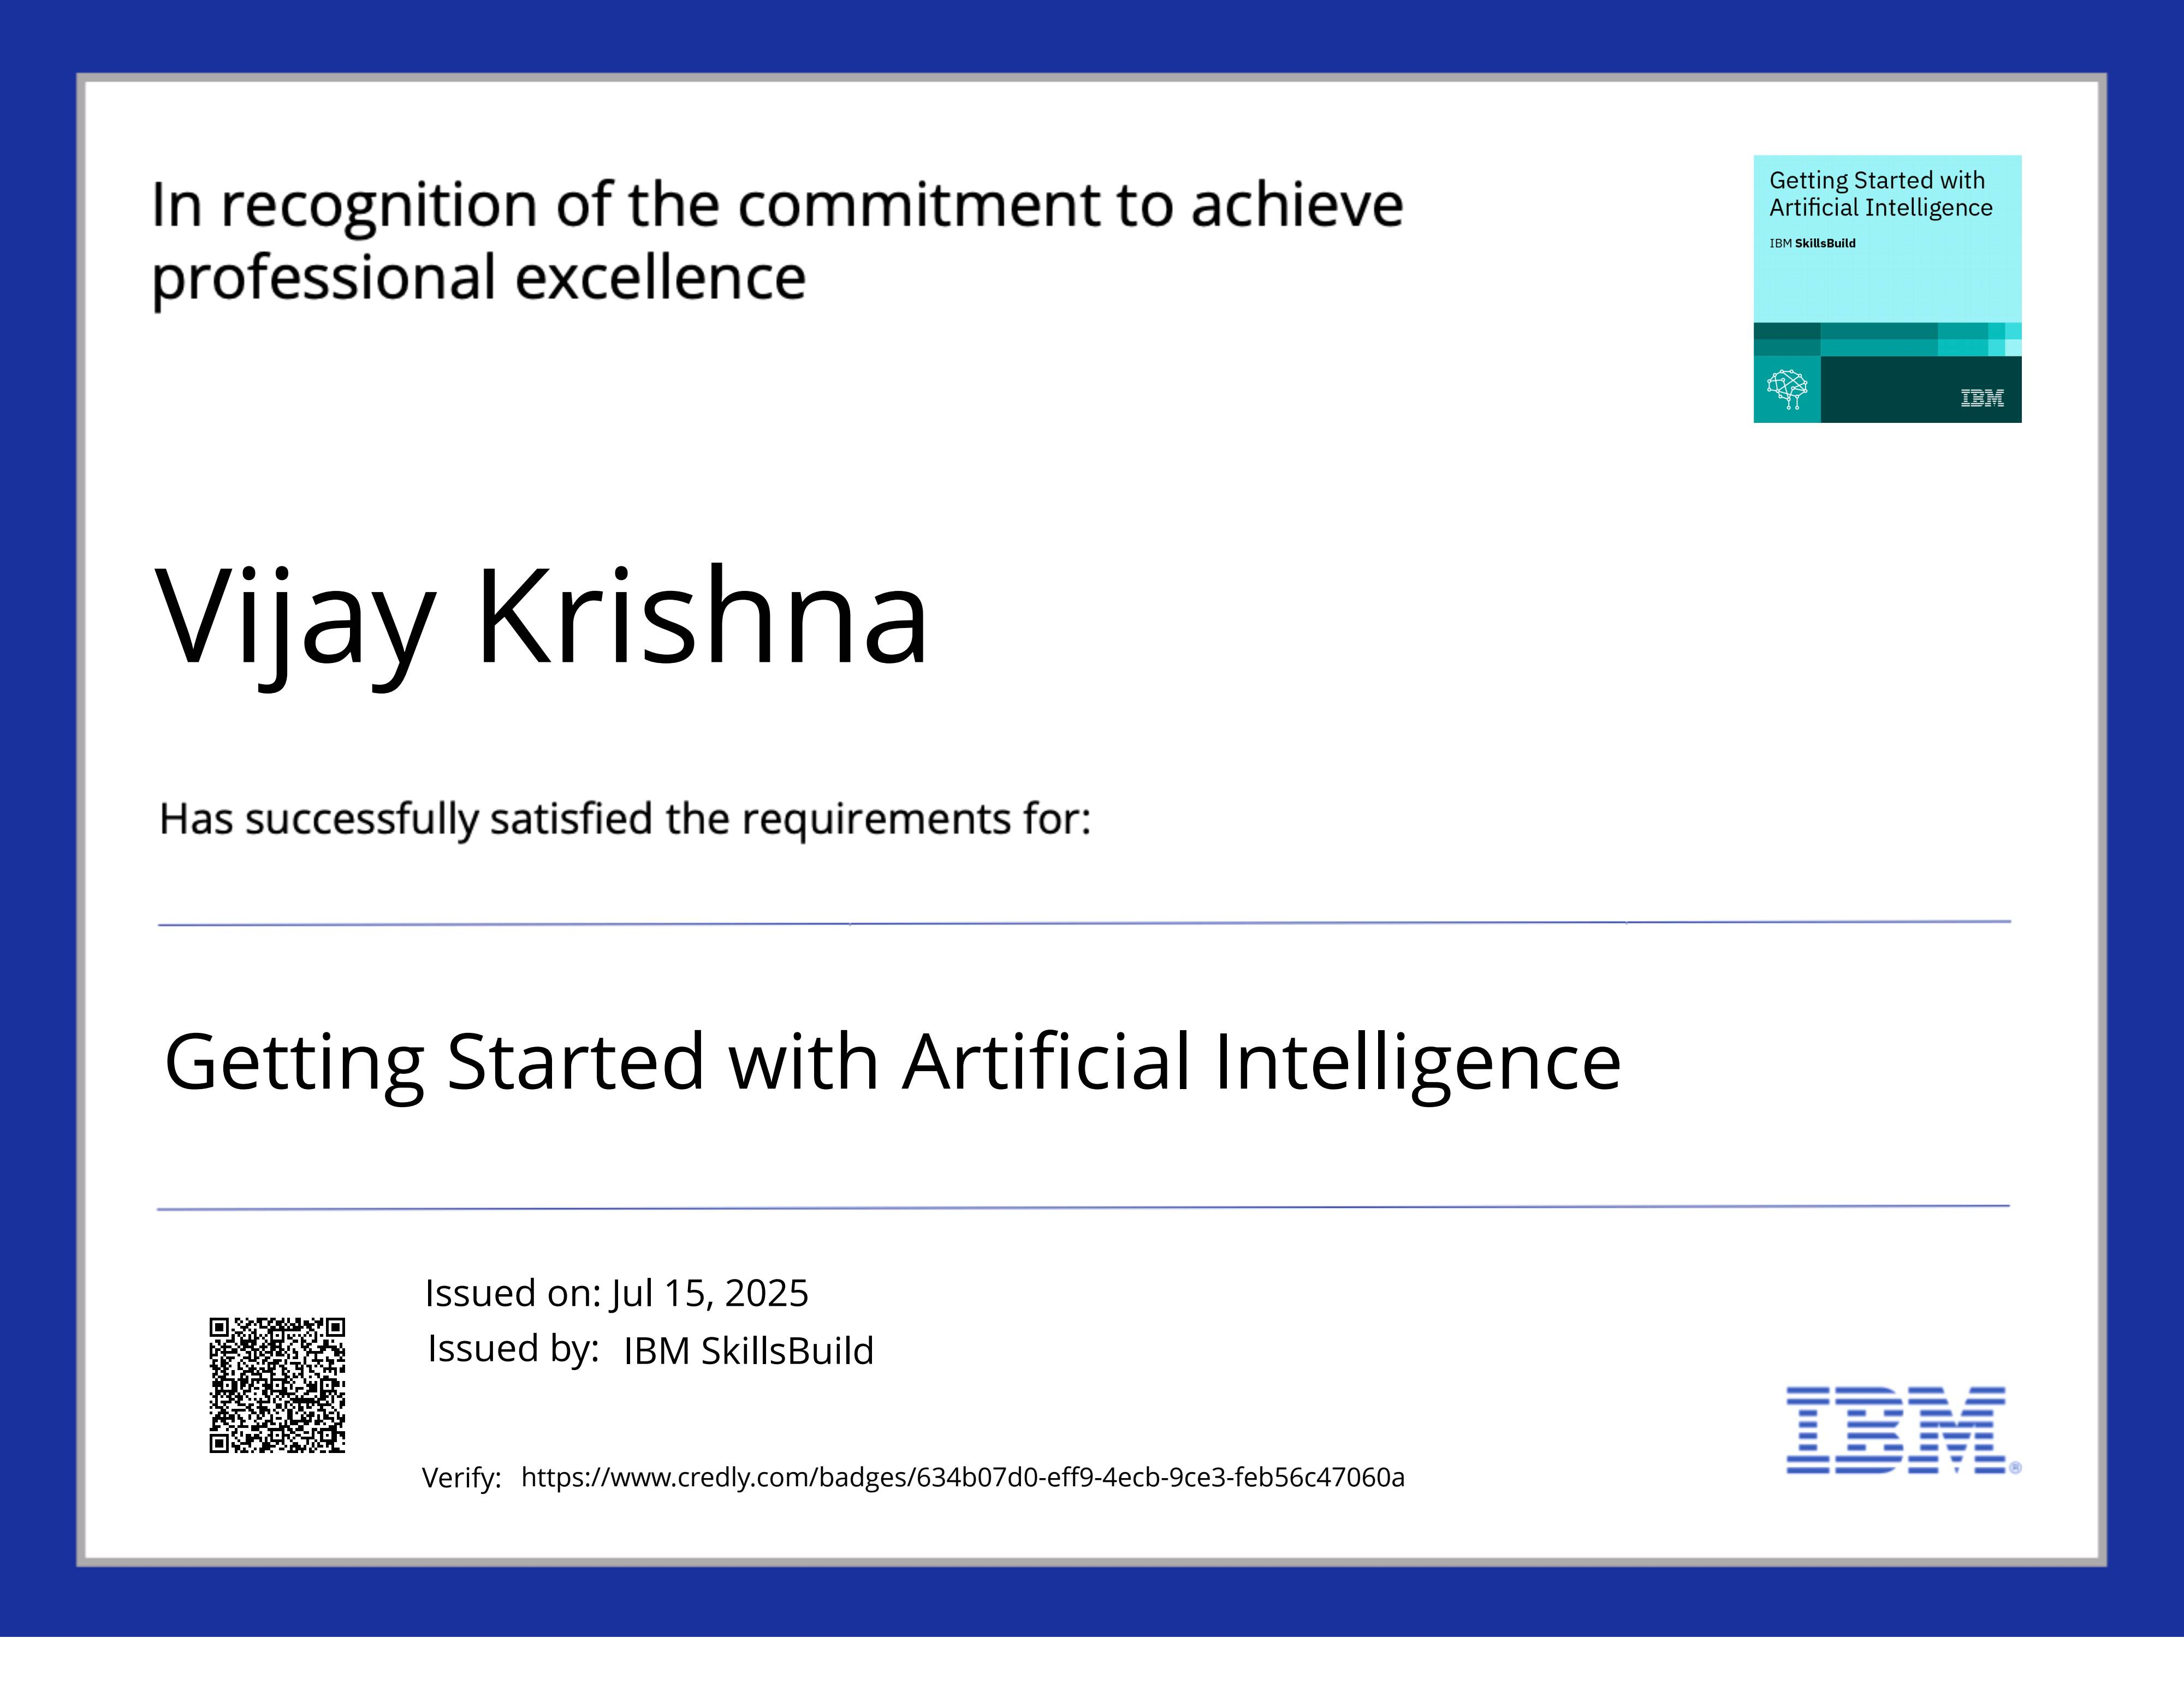
IBM Certifications

Slide 14
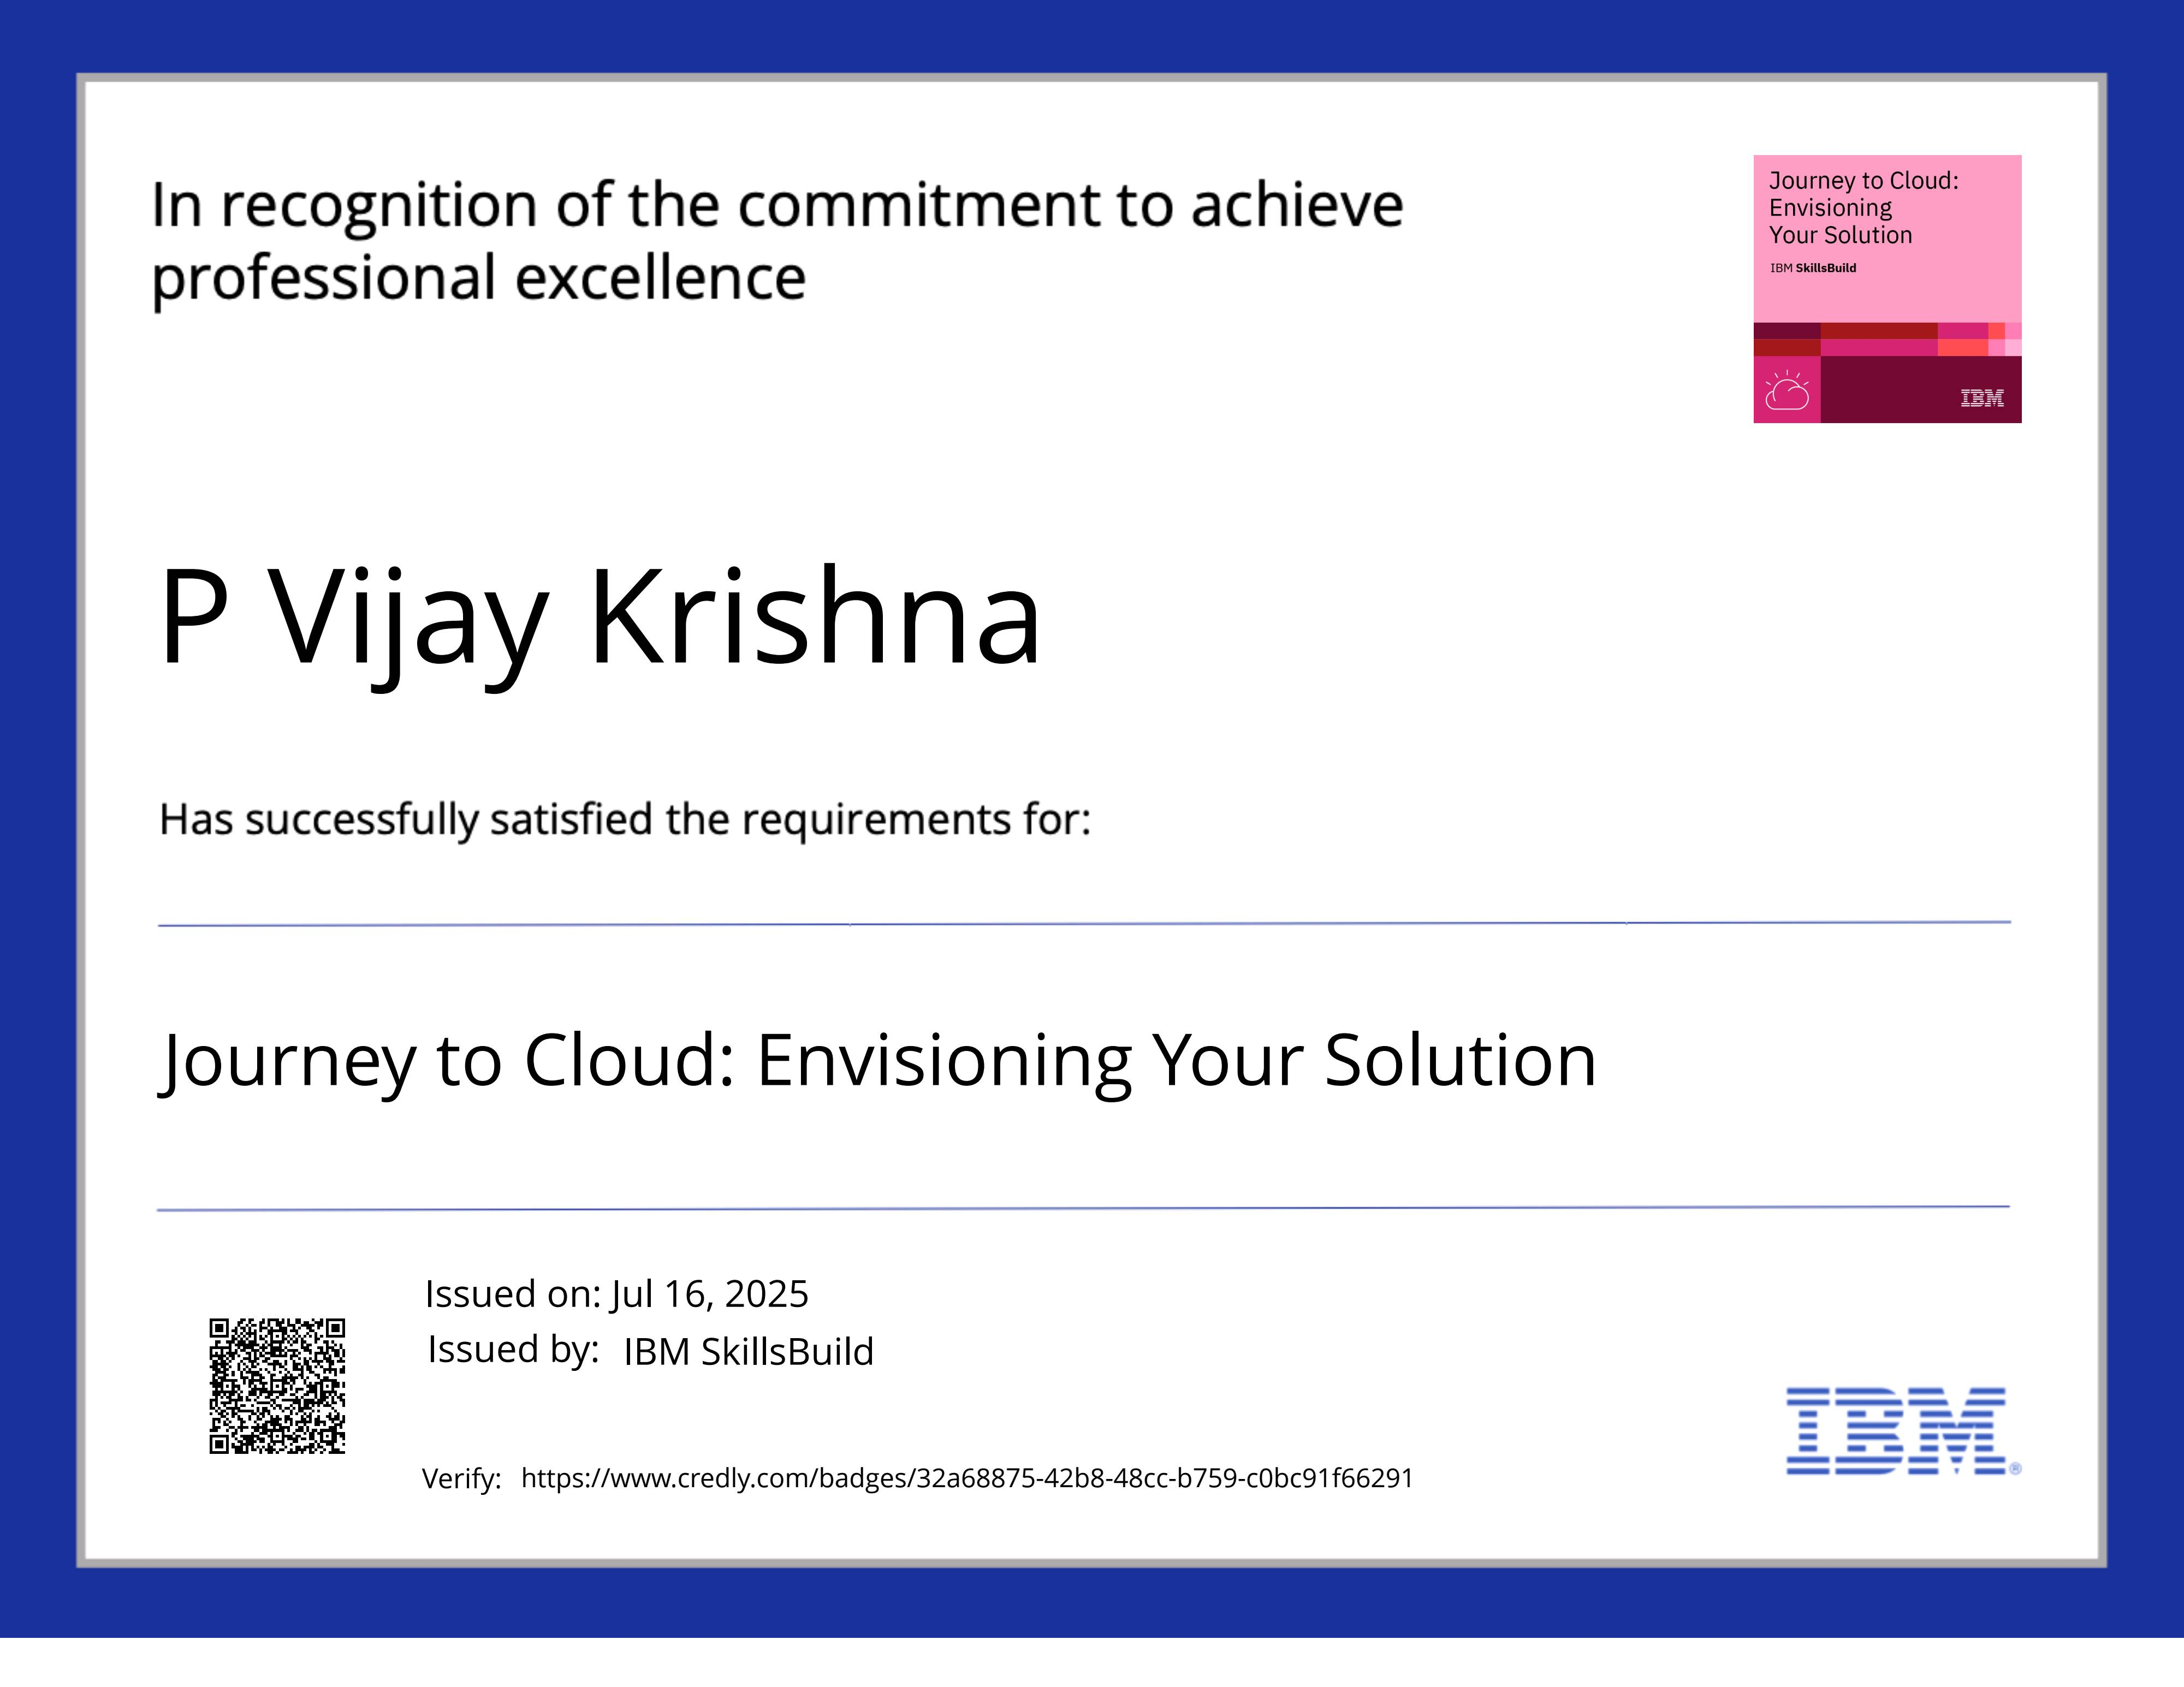
IBM Certifications

Slide 15
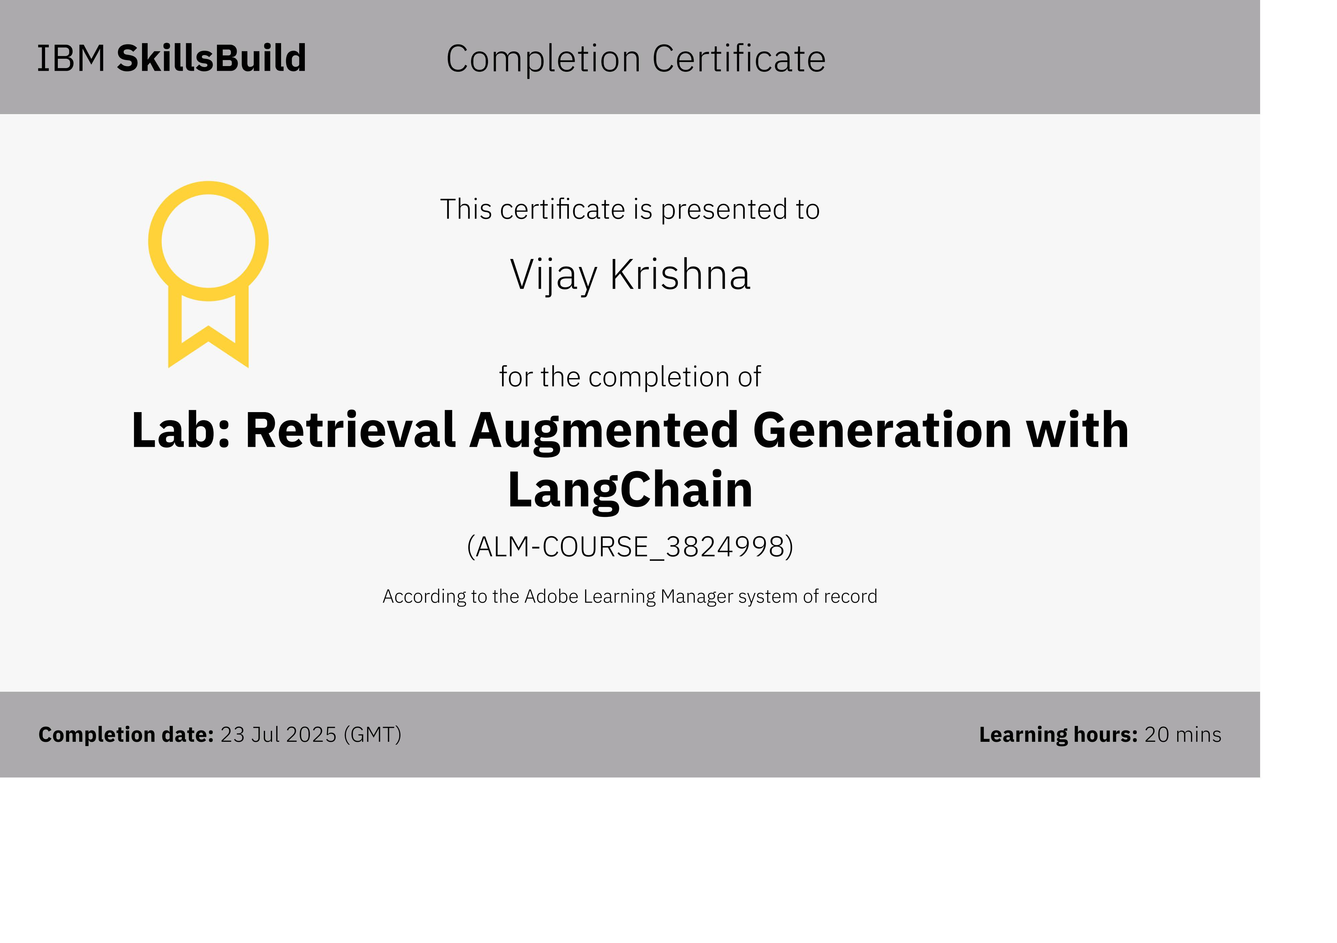
IBM Certifications

Slide 16
THANK YOU

